Slide 1
Generative Models vs Traditional AI-Driven Anomaly Detection in Large-Scale System Logs
A Comparative Study
Muhammad Asad Mahmood Khan [Roll No: 243260] Program: MSAI-3 (Fall 2024) Air University, Department of Creative Technologies

Slide 2
Presentation Agenda
•
1. System Logs: Definition & Generation
•
7. Methodology
•
2. Log Anomalies: Types & Impact of Detection
•
8. Dataset Strategy
•
3. Detection Evolution & Literature Review
•
9. Experimental Setting (Trad/DL/GenAI)
•
4. Problem Statement
•
10. Results & Synthesis
•
5. Research Questions (RQs)
•
11. Discussion on Results
•
6. Research Objectives
•
12. Future Work & Conclusion
MSAI Thesis Defense
Slide 2

Slide 3
1. System Logs
What they are, why they are generated, and what they record
What are System Logs?
Records of events and activities occurring in an operating system, server, network device, or application.
They act like a “diary” of the computer, recording important events such as logins, errors, service starts, and device connections.
Typical information includes timestamps, usernames, IP addresses, processes, event types, and success/failure status.
Why are they generated?
Troubleshooting — identify errors and failures.
Security — detect suspicious or unauthorized activity.
Monitoring — observe system and service health.
Auditing — track important changes and actions.
Investigation — reconstruct events after an incident.
Common Types
Authentication logs — successful/failed logins and password changes.
Application logs — application starts, errors, exceptions, and transactions.
Operating-system logs — boot, shutdown, service, and hardware events.
Security logs — suspicious activity, permission changes, malware, and firewall events.
Network logs — connections, blocked traffic, DNS, VPN, and firewall activity.
Example
20:15:42 SSH Failed password user=asad source=192.168.1.50
Key idea: Logs help people and security tools understand what happened, when it happened, and often why.

Slide 4
2. Log Anomalies
Unusual, unexpected, or abnormal events and patterns found in system logs.
Common Types
• Frequency anomaly — too many or too few events
• Time anomaly — activity at an unusual time
• Pattern anomaly — unexpected sequence of events
• Volume anomaly — unusually large log/data volume
• User behavior anomaly — activity differs from normal
Other Important Types
• IP/Location anomaly — unusual source or location
• Error anomaly — sudden increase in errors
• Security anomaly — activity suggesting an attack
• Resource anomaly — unusual CPU, memory, or disk use
• Configuration anomaly — unexpected system changes
Example: Possible Brute-Force Attack
• 03:12 Failed login → 03:13 Failed login → 03:14 Failed login → 03:15 Successful login
Log anomalies help detect system failures, unusual behavior, and potential cybersecurity threats.

Slide 5
3. Why is log anomaly detection important?
Detecting abnormal log activity helps organizations identify threats and system problems early.
Security & Early Warning
• Detects brute-force attacks and unauthorized access
• Identifies malware and suspicious user behavior
• Provides early warning before damage increases
• Enables faster security response
Operations & Investigation
• Finds errors, crashes, and service failures
• Reduces manual monitoring of large log volumes
• Shows what happened, when, and what was affected
• Supports incident investigation and auditing
Simple Example
• Normal: 10 failed logins/day → Anomaly: 500 failed logins in 5 minutes → Alert & investigation
Early anomaly detection helps organizations respond faster, reduce risk, and prevent serious damage.

Slide 6
4. Literature Review (Traditional ML & Deep Learning)
Paper Name & Citation | Dataset | Anomaly | Mode (Model/Method) | Result (Performance)
Detecting Large-Scale System Problems... (Xu et al., 2009) | HDFS, Darkstar | Binary | PCA (Principal Component Analysis) | F1: ~0.93
Mining Invariants from Console Logs... (Lou et al., 2010) | Hadoop, HDFS | Binary | Invariant Mining (Unsupervised) | Recall: ~0.90
Experience Report: System Log Analysis... (He et al., 2016) | HDFS, BGL | Binary | Log Clustering, PCA, IM | F1: 0.88 - 0.95
Isolation Forest (Applied to Logs) (Liu et al., 2008) | HDFS, BGL | Binary | iForest (Tree-based Ensemble) | F1: ~0.73
DeepLog: Anomaly Detection... (Du et al., 2017) | HDFS, OpenStack | Binary | LSTM (Next-Key Prediction) | F1: 0.96
LogAnomaly: Unsupervised Detection... (Meng et al., 2019) | HDFS, BGL | Binary | LSTM + Template2Vec (Attention) | F1: 0.97
Robust Log-based Anomaly Detection... (Zhang et al., 2019) | HDFS, BGL | Binary | Bi-LSTM + Attention | F1: ~0.98

Slide 7
Literature Review (Generative AI)
Paper Name & Citation | Dataset | Anomaly | Mode (Model/Method) | Result (Performance)
LogBERT: Log Anomaly Detection via BERT (Guo et al., 2021) | HDFS, BGL | Binary | BERT (Masked Language Model) | F1: 0.993
LogGAN: A Generative Adversarial Network... (Xia et al., 2020) | HDFS, BGL | Binary | LSTM-GAN (Generator-Discriminator) | F1: ~0.95
LogPrompt: Prompt Engineering... (Liu et al., 2023) | HDFS, BGL | Binary | LLM Prompting (ChatGPT/GPT-4) | F1: ~0.98+
LSTM-Based VAE-GAN for Time-Series... (Xu et al., 2020) | HDFS (Time Series) | Binary | VAE-GAN (Variational Autoencoder) | F1: ~0.94
Mask-Guided Anomaly Detection (FastLogAD) (Lin et al., 2024) | HDFS, Thunderbird | Binary | Masked Generator (GenAI-based) | F1: ~0.99

Slide 8
5. Problem Statement & Research Gap
The Functional Dichotomy
Brittleness of Supervised ML: Traditional models (SVM, XGBoost) achieve F1 > 0.99 but require rigid manual feature extraction. They fail entirely when log syntax or system architectures change.
Inefficacy of Unsupervised Baselines: Traditional unsupervised methods (e.g., Isolation Forest) struggle with sequential dependencies, yielding poor detection rates on unknown errors.
The Critical Research Gap
Most existing literature benchmarks models on a single dataset (usually HDFS) in isolation. There is no proven, unified framework combining supervised accuracy with generalized, unsupervised flexibility across diverse architectures.

Slide 9
6. Research Questions & Objectives
Research Questions (RQs)
RQ1 (Generalization): Do Generative AI models maintain consistent performance across heterogeneous systems (e.g., HDFS to Spark) compared to Traditional Supervised models?
RQ2 (Automation & Zero-Day): Can Generative Deep Learning eliminate manual feature engineering while outperforming traditional unsupervised baselines on unknown anomalies?
Research Objectives
Benchmark Traditional ML: Evaluate limits of XGBoost/SVM and Isolation Forest on HDFS.
Evaluate Deep Learning: Implement discriminative models (LSTM, GRU) on temporal sequences.
Validate Generative AI: Develop normal-only models (LSTM-AE, VAE) to detect zero-day errors.
Tri-Fold Comparative Study: Produce a cross-platform matrix across HDFS, Spark, and Hadoop.

Slide 10
7. Methodology (5-Phase Framework)
Multi-Source Dataset Collection: Aggregating logs from HDFS (block data), Spark (task execution), and Hadoop setups.
Log Preprocessing & Parsing: Utilizing Drain Parser for template extraction, event ID mapping, and timestamp normalization.
Comparative Model Training: Executing 3 distinct pipelines: Traditional ML, Deep Learning, and Generative Al.
Cross-Platform Testing: Applying an 80/20 train-test split; evaluating models independently on unseen architectures.
Comparative Analysis: Evaluating quantitative metrics alongside functional automation and zero-day capabilities.

Slide 11
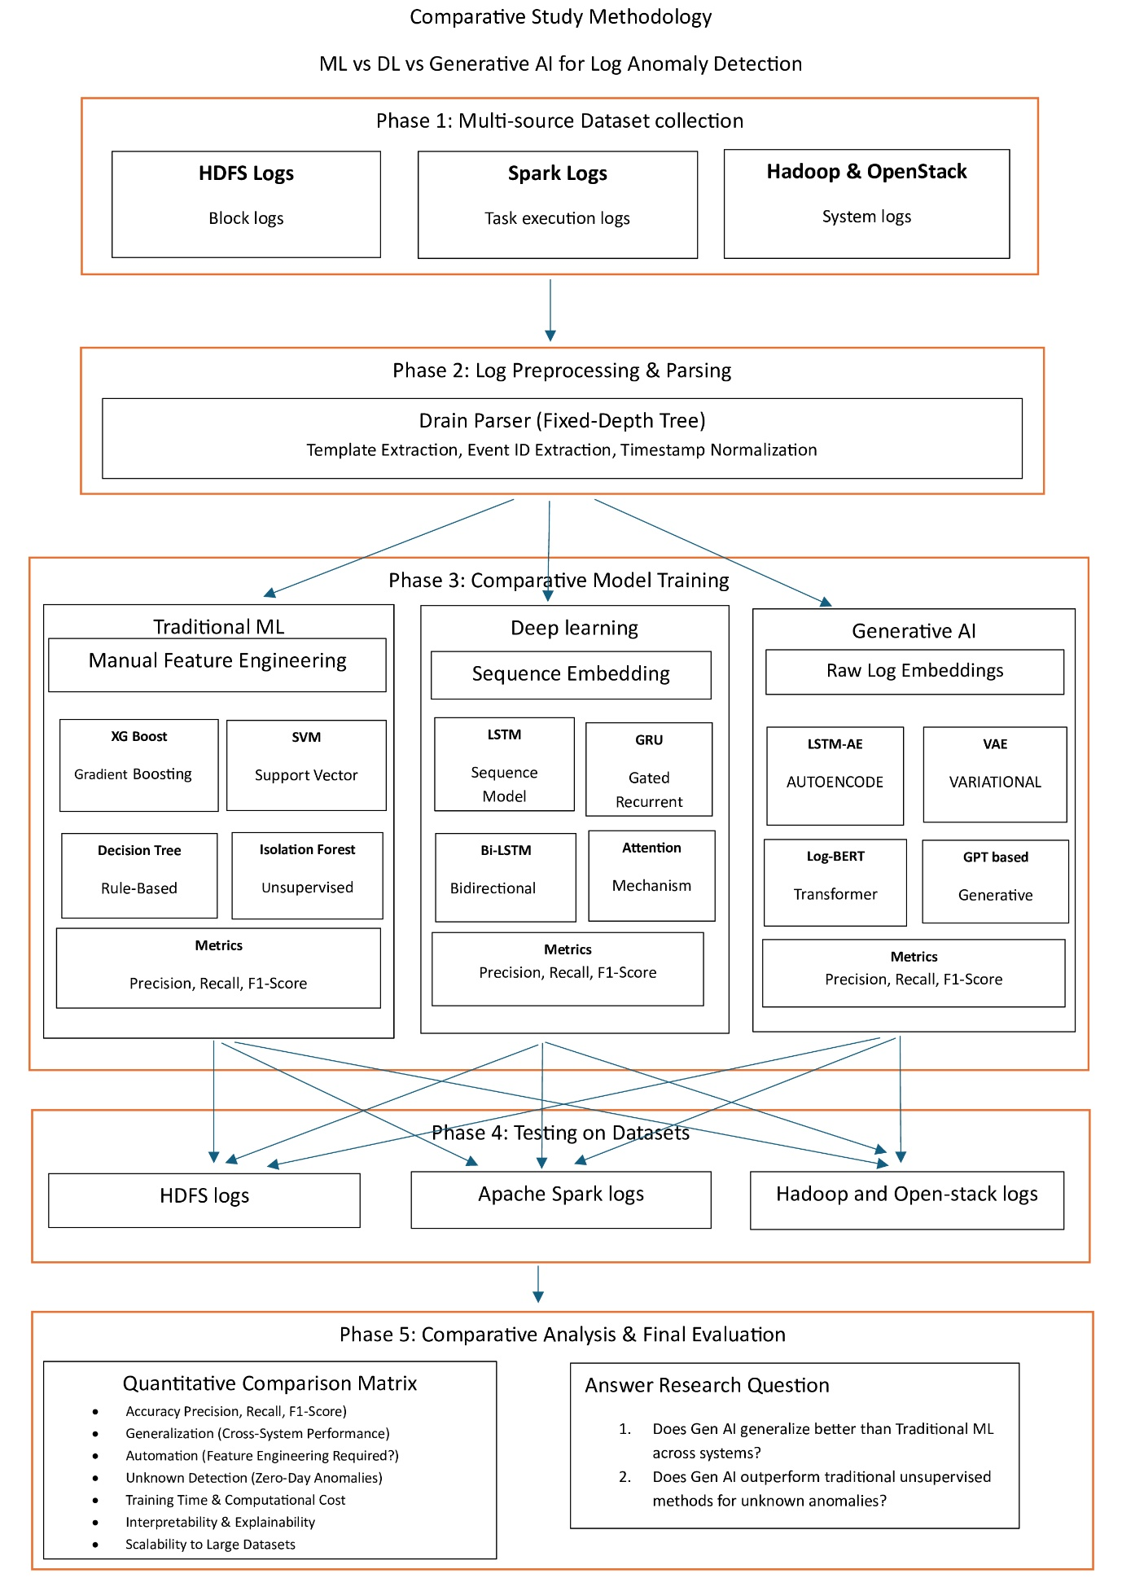

Slide 12



8. Dataset Strategy
HDFS v1
Apache Spark
Hadoop / OpenStack
The "Gold Standard"
The Generalization Test
Broader Validation
Contains over 575,000 block logs with labeled "Normal" and "BlockCorrelation" failures. Used to train and stringently benchmark all
initial model types.
Contains highly complex, overlapping task execution logs. Used exclusively to evaluate inter-system transfer learning and architectural robustness.
Broader system-level logs utilized for final cross-platform validation to ensure selected models do not memorize application-specific syntaxes.

Slide 13
9. Experimental Setting (Comparative Pipelines)
Pipeline 1: Traditional ML
Pipeline 2: Deep Learning
Pipeline 3: Generative AI
Input: Parsed Log Templates.
Feature Eng: Manual TF-IDF & Event Count Matrices.
Models: XGBoost, SVM, Random Forest, Isolation Forest.
Input: Raw Log Embeddings.
Method: Unsupervised. Learns "normal" distribution only; flags deviations.
Models: LSTM-Autoencoder, VAE, GAN.
Input: Tokenized Log Sequences.
Method: Supervised learning on temporal execution paths.
Models: LSTM, GRU, CNN, Bi-LSTM.

Slide 14
10a. Results: HDFS Baseline Evaluation
Testing completed on 115,013 holdout instances (111,645 normal / 3,368 anomalies).
Model | Category | Precision | Recall | F1-Score | ROC-AUC
XGBoost | Traditional ML (Sup) | 99.85% | 99.97% | 99.91% | --
SVM | Traditional ML (Sup) | 96.34% | 99.94% | 98.11% | --
LSTM | Deep Learning (Sup) | 98.08% | 99.88% | 98.97% | 100%
LSTM-AE | Generative (Unsup) | 72.32% | 88.18% | 79.46% | 99.64%
VAE | Generative (Unsup) | 69.44% | 74.29% | 71.78% | 98.76%

Slide 15


10b. Results: Spark & Hadoop Evaluation
Apache Spark Logs
Hadoop Logs
•
Traditional ML: Isolation forest achieved ROC-AUC 0.95, but F1 was only 0.04. Random Forest peaked at F1 0.44.
•
Traditional ML: Random Forest achieved perfect metrics (F1 1.00).
•
Deep Learning: CNN recovered performance (F1 0.91).
•
Deep Learning: CNN achieved Recall 1.00 but Precision 0.09 (F1 0.16).
•
Generative AI: LSTM-AE dropped relative to HDFS, achieving F1 0.45.
•
Generative AI: LSTM-AE generated 16,562 False Positives (F1 0.05).

Slide 16
10c. Overall Synthesis Matrix
Model | Category | HDFS F1 | Spark F1 | Hadoop F1
XGBoost | Traditional ML (Supervised) | 0.9991 | - | -
SVM | Traditional ML (Supervised) | 0.9811 | - | -
Random Forest | Traditional ML (Supervised) | - | 0.44 | 1
LSTM | Deep Learning (Supervised) | 0.9897 | - | -
GRU | Deep Learning (Supervised) | 0.9899 | - | -
CNN Classifier | Deep Learning (Supervised) | - | 0.16 | 0.91
Isolation Forest | Traditional ML (Unsupervised) | - | 0.04 | 0.6
One-Class SVM | Traditional ML (Unsupervised) | - | 0 | 0.32
LSTM Autoencoder | Generative / Unsupervised DL | 0.7946 | 0.05 | 0.45
VAE / LSTM-VAE | Generative | 0.7178 | 0.01 | 0.12
GAN | Generative | - | 0.01 | 0.03

Slide 17
11. Discussion on Results (Key Takeaways)
1. The "HDFS Illusion”
Nearly all evaluated models work exceptionally well on structured HDFS datasets (F1 > 90%). This creates a false sense of security in the literature, making anomaly detection appear artificially solved.
2. The "Spark Reality Check"
Complex, asynchronously overlapping Spark logs break almost every evaluated model (F1 < 0.50). This proves a severe lack of true functional transferability in current supervised paradigms.
3. The "Generative Struggle”
Generative models successfully eliminate manual feature engineering and identify zero-day anomalies via strong ROC-AUC. However, they are highly noise-sensitive, leading to massive false positive rates on dynamic systems.

Slide 18
12. Conclusion & Future Work
Future Work
Dynamic Thresholding:
Implementing Extreme Value Theory (EVT) to adjust reconstruction thresholds and reduce false positives.
Concept Drift Mitigation:
Online learning to adapt to evolving log formats in real-time.
Hybrid Frameworks:
Developing neuro-symbolic models combining ensemble precision with generative semantic understanding.
Conclusion (The Trade-Off)
Traditional ML:
Near-perfect on structured data, but entirely brittle and requires manual engineering.
Supervised DL:
Removes manual extraction but remains highly volatile on noisy logs (e.g., Spark).
Generative Al:
Provides a valuable zero-day baseline due to normal-only training, but low raw F1 limits standalone production readiness.

Slide 19
Questions & Discussion
Thank you for your attention.

